Slide 1
Comparing Numbers
EQ: What symbols do I use to compare numbers?

Slide 2
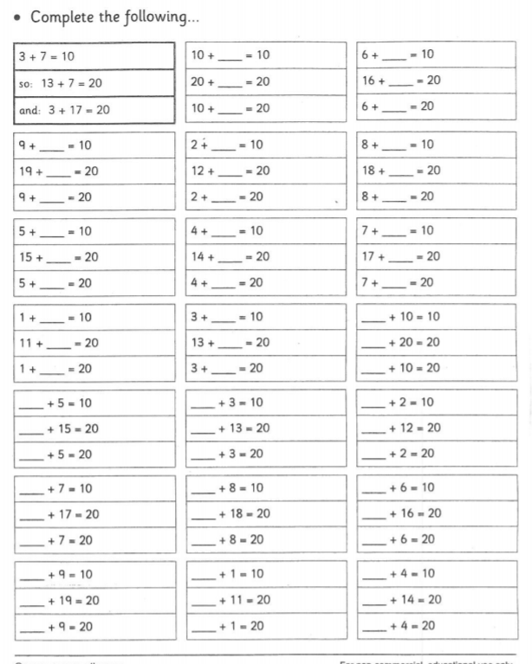
Number bonds to 20 Mental Arithmatic
7_Number bonds to 20 Mental Arithmatic worksheet

Slide 3

Welcome Charlie the Crocodile
Charlie the Crocodile LOVES eating numbers….

Slide 4
However, Charlie is a very fussy eater…
8
2
5
9
1
7
… he only ever eats the biggest number he can see!

Slide 5

So if we have the numbers:
5
2
Which number will Charlie try to eat???

Slide 6

How can we show this mathematically?
5
2
5
>
2

Slide 7
>
Greater than
<
Less than

Slide 8
Charlie’s past meals
45 | > | 30
95 | > | 80
10 | < | 50
26 | > | 24
55 | > | 42
61 | < | 64
34 | < | 38
150 | < | 180

Slide 9
Which number could be missing?
Two column notes with the headings less than and greater than. Students to put the full number sentence in the correct column. Time
32 | > | ?

Slide 10
Which number could be missing?
41 | < | ?

Slide 11
Which number could be missing?
29 | > | ?

Slide 12
Which number could be missing?
72 | > | ?

Slide 13
Which number could be missing?
46 | < | ?

Slide 14
Which number could be missing?
53 | > | ?

Slide 15
Which number could be missing?
34 | < | ?

Slide 16
Which number could be missing?
125 | < | ?

Slide 17
Which number could be missing?
164 | > | ?

Slide 18
Which number could be missing?
183 | < | ?

Slide 19
Which number could be missing?
205 | > | ?

Slide 20
Which number could be missing?
513 | < | ?

Slide 21
Which SYMBOL is missing?
89 |  | 42

Slide 22
Which SYMBOL is missing?
29 |  | 54

Slide 23
Which SYMBOL is missing?
118 |  | 142

Slide 24
Which SYMBOL is missing?
100 |  | 49

Slide 25
Which SYMBOL is missing?
17 |  | 25

Slide 26
Which SYMBOL is missing?
37 |  | 42

Slide 27
Which SYMBOL is missing?
66 |  | 70

Slide 28
Which SYMBOL is missing?
55 |  | 14

Slide 29
Which SYMBOL is missing?
83 |  | 43

Slide 30
Which SYMBOL is missing?
10 |  | 4

Slide 31
Which SYMBOL is missing?
152 |  | 182

Slide 32
Practice
7_ More than less than worksheet 1.docx
7_ More than less than worksheet 1.2.docx
7_ More than less than worksheet 2.docx

